Slide 1
Actor Framework: Navigating the Framework through
Linked Calls
AF created by
Stephen Loftus-Mercer and Allen C Smith
The actor model in computer science is a mathematical model of concurrent computation that treats an actor as the basic building block of concurrent computation.
In response to a message it receives, an actor can: make local decisions, create more actors, send more messages, and determine how to respond to the next message received.
Actors may modify their own private state, but can only affect each other indirectly through messaging (removing the need for lock-based synchronization).
Actor model
compiled by Nathan Davis
Physics Ph.D Student
Sánchez Nano Dev. Lab. Portland, Oregon

Slide 2
Method / Class scope colors
+Public
-Private
~Community
#Protected

Slide 3
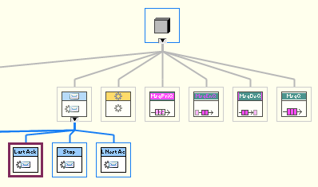
AF.lib:
Contained elements:
AF.lib:Message.lvclass
AF.lib:Stop Msg.lvclass
AF.lib:Last Ack.lvclass
AF.lib:Launch Nested Actor Msg.lvclass
AF.lib:Actor.lvclass
AF.lib:Message Priority Queue.lvclass
AF.lib:Message Enqueuer.lvclass
AF.lib:Message Dequeuer.lvclass
AF.lib:Message Queue.lvclass
AF.lvlib:Init Actor Queues FOR TESTING ONLY.vi

Slide 4
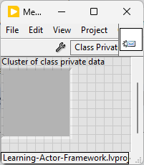

AF.lib:Message.lvclass
Contained elements:
AF.lib:Message.lvclass:Drop Message.vi
AF.lib:Message.lvclass:Drop Message Core.vi
AF.lib:Message.lvclass:Do.vi
Friends: AF.lib:Actor.lvclass
Change this to.. just Actor.lvclass:Actor.vi, since it is the only place being accessed?

Slide 5
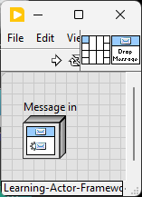
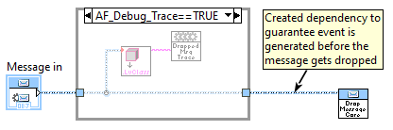
AF.lib:Message.lvclass:Drop Message.vi
Called directly in:
AF.lib:Actor.lvclass:Actor.vi

Slide 6
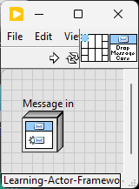
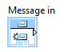
AF.lib:Message.lvclass:Drop Message Core.vi
Called directly in:
AF.lib:Message.lvclass:Drop Message.vi

Slide 7
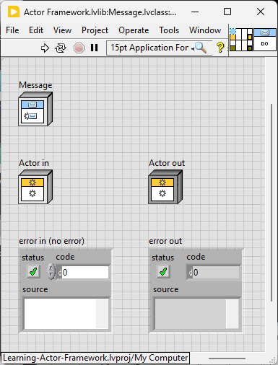
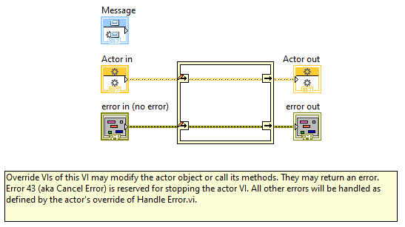
AF.lib:Message.lvclass:Do.vi
Called directly in:
AF.lib:Actor.lvclass:Receive Message.vi

Slide 8
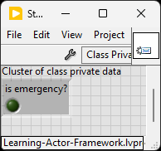
AF.lib:Stop Msg.lvclass
Contained elements:
AF.lib:Stop Msg.lvclass:Send Normal Stop.vi
AF.lib:Stop Msg.lvclass:Send Emergency Stop.vi
AF.lib:Stop Msg.lvclass:Send Normal or Emergency Stop.vi
AF.lib:Stop Msg.lvclass:Do.vi
No Friends

Slide 9
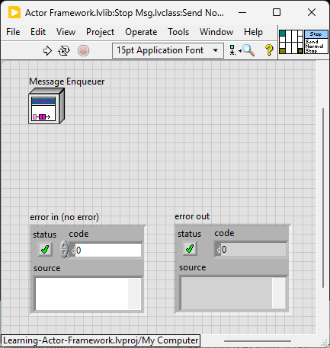
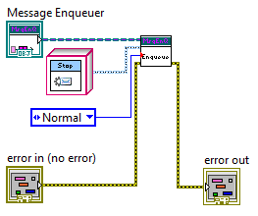
AF.lib:Stop Msg.lvclass:Send Normal Stop.vi
Called directly in:
AF.lib:Stop Msg.lvclass:Send Normal or Emergency Stop.vi

Slide 10

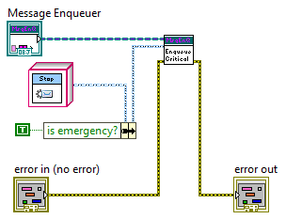
AF.lib:Stop Msg.lvclass:Send Emergency Stop.vi
Called directly in:
AF.lib:Stop Msg.lvclass:Send Normal or Emergency Stop.vi

Slide 11
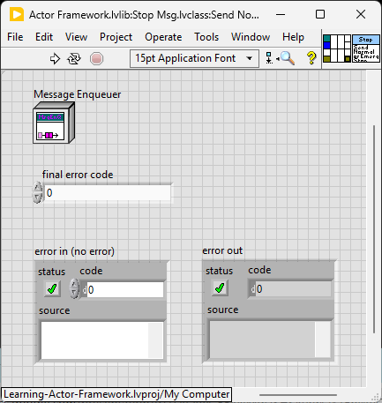
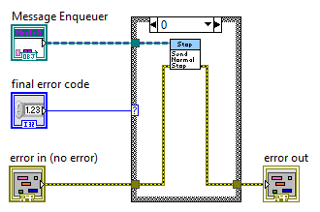
AF.lib:Stop Msg.lvclass:Send Normal or Emergency Stop.vi
Called directly in:
AF.lvlib:Actor.lvclass:Stop Core.vi

Slide 12
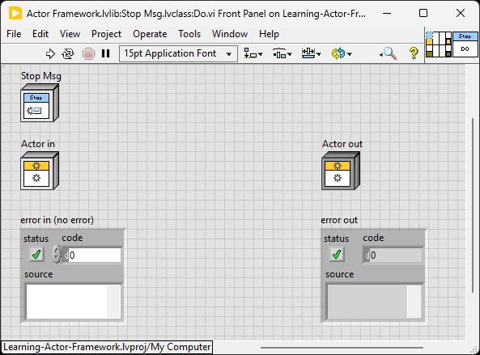
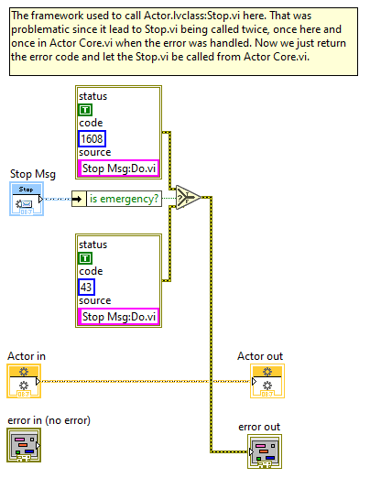
AF.lib:Stop Msg.lvclass:Do.vi
Called directly in:
AF.lvlib:Actor.lvclass:Receive Message.vi
AF.lvlib:Actor.lvclass (is friend of this method)

Slide 13
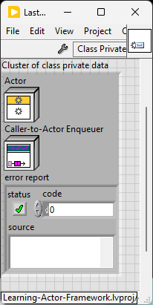
AF.lib:Last Ack.lvclass
Contained elements:
AF.lib:Last Ack.lvclass:Send Last Ack.vi
AF.lib:Last Ack.lvclass:Do.vi
AF.lib:Last Ack.lvclass:Read Actor.vi
AF.lib:Last Ack.lvclass:Read Error Report.vi
AF.lib:Last Ack.lvclass:Read Caller-To-Actor Enqueuer.vi
Friends: AF.lib:Actor.lvclass:Actor.vi

Slide 14
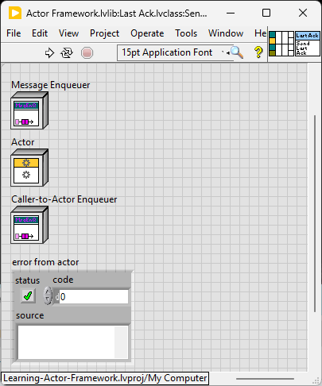
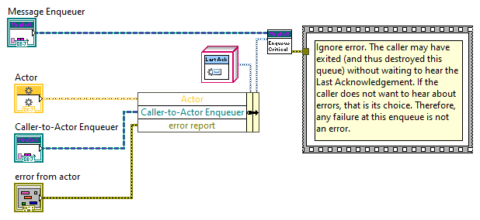
AF.lvlib:Last Ack.lvclass:Send Last Ack.vi
Called directly in:
AF.lvlib:Actor.lvclass:Actor.vi

Slide 15
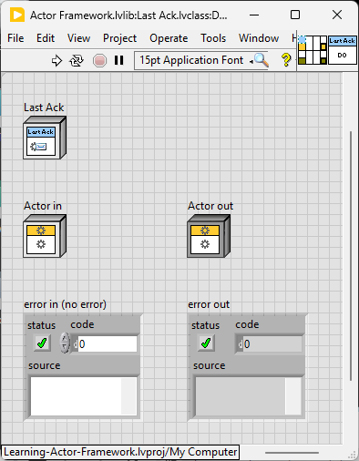
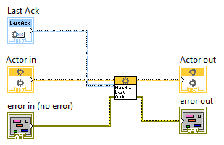
AF.lvlib:Last Ack.lvclass:Do.vi
Called directly in:
AF.lvlib:Actor.lvclass:Receive Message.vi
AF.lvlib:Actor.lvclass (is friend of this method)

Slide 16
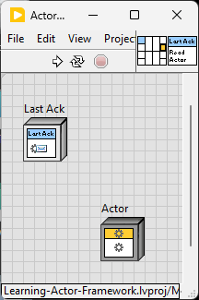
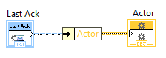
AF.lvlib:Last Ack.lvclass:Read Actor.vi
No direct calls

Slide 17
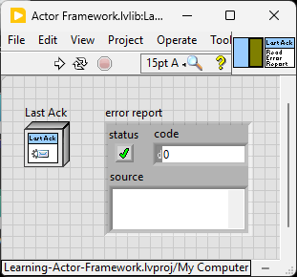
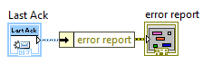
AF.lvlib:Last Ack.lvclass:Read Error Report.vi
Called directly in:
AF.lvlib:Actor.lvclass:Handle Last Ack Core.vi

Slide 18
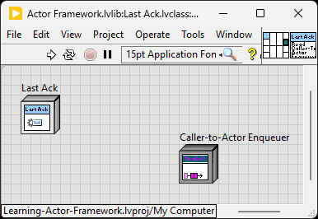
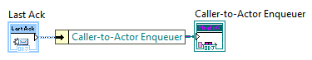
AF.lvlib:Last Ack.lvclass:Read Caller-To-Actor Enqueuer.vi
Called directly in:
AF.lvlib:Actor.lvclass:Handle Last Ack.vi

Slide 19
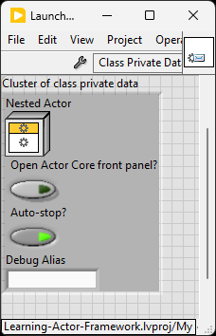
AF.lvlib:Launch Nested Actor Msg.lvclass
Contained elements:
AF.lvlib:Launch Nested Actor Msg.lvclass:Do.vi
AF.lvlib:Launch Nested Actor Msg.lvclass:Initialize.vi
No Friends

Slide 20
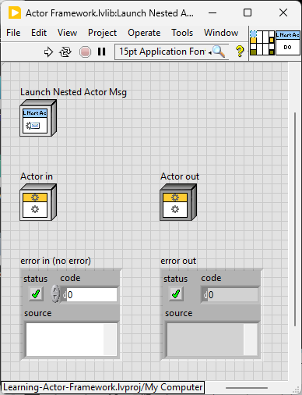
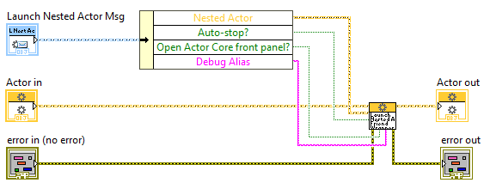
AF.lvlib:Launch Nested Actor Msg.lvclass:Do.vi
Called directly in:
AF.lvlib:Actor.lvclass:Receive Message.vi
AF.lvlib:Actor.lvclass (is friend of this method)

Slide 21
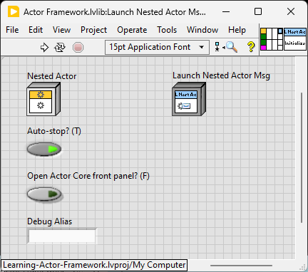
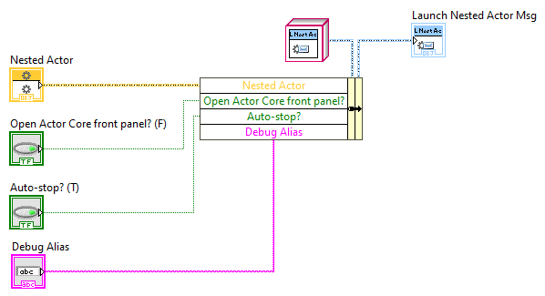
AF.lvlib:Launch Nested Actor Msg.lvclass:Initialize.vi
Called directly in:
AF.lvlib:Actor.lvclass:Send Launch Nested Actor Msg.vi

Slide 22
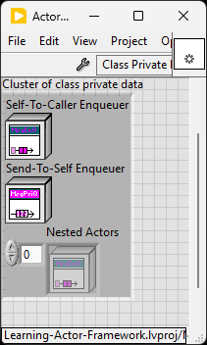
AF.lvlib:Actor.lvclass
Contained elements:
AF.lvlib:Actor.lvclass:Handle Last Ack.vi
AF.lvlib:Actor.lvclass:Init Check.vi
AF.lvlib:Actor.lvclass:Init Queues.vi
AF.lvlib:Actor.lvclass:Launch Nested Actor Friend Wrapper.vi
AF.lvlib:Actor.lvclass:Actor.vi
AF.lvlib:Actor.lvclass:Record Nested Actor.vi
AF.lvlib:Actor.lvclass:Stop.vi
AF.lvlib:Actor.lvclass:Count Actors.vi
AF.lvlib:Actor.lvclass:Launch Actor Core.vi
AF.lvlib:Actor.lvclass:Actor Core.vi
AF.lvlib:Actor.lvclass:Stop Core.vi
AF.lvlib:Actor.lvclass:Handle Last Ack Core.vi
AF.lvlib:Actor.lvclass:Read Self Enqueuer.vi
AF.lvlib:Actor.lvclass:Read Caller Enqueuer.vi
AF.lvlib:Actor.lvclass:Read Autostop Nested Actor Count.vi
AF.lvlib:Actor.lvclass:Receive Message.vi
AF.lvlib:Actor.lvclass:Handle Error.vi
AF.lvlib:Actor.lvclass:Pre Launch Init.vi
AF.lvlib:Actor.lvclass:Substitute Actor.vi
AF.lvlib:Actor.lvclass:Send Launch Nested Actor Msg.vi
AF.lvlib:Actor.lvclass:Launch Nested Actor.vi
AF.lvlib:Actor.lvclass:Launch Actor.vi
AF.lvlib:Actor.lvclass:Launch Root Actor.vi
Friends: AF.lvlib:Init Actor Queues FOR TESTING ONLY.vi
AF.lvlib:Last Ack.lvclass:Do.vi
AF.lvlib:Launch Nested Actor Msg.lvclass:Do.vi
AF.lvlib:Stop Msg.lvclass:Do.vi

Slide 23
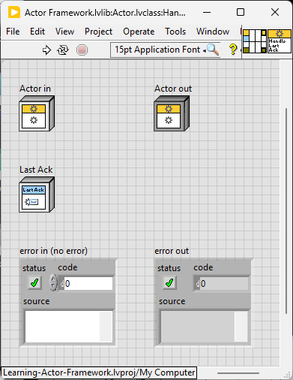
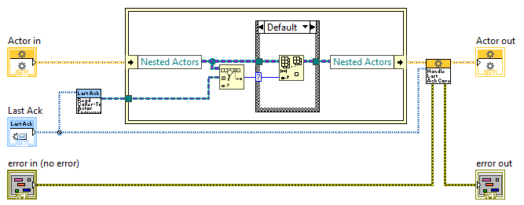
AF.lvlib:Actor.lvclass:Handle Last Ack.vi
Called directly in:
AF.lvlib:Last Ack.lvclass:Do.vi

Slide 24
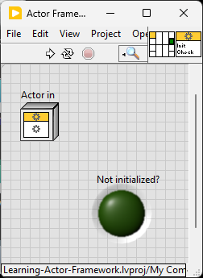
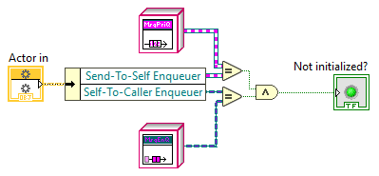
AF.lvlib:Actor.lvclass:Init Check.vi
Called directly in:
AF.lvlib:Init Actor Queues FOR TESTING ONLY.vi

Slide 25
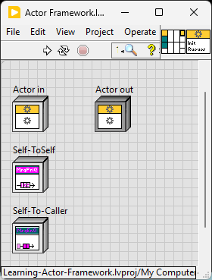
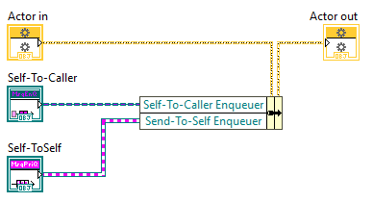
AF.lvlib:Actor.lvclass:Init Queues.vi
Called directly in:
AF.lvlib:Init Actor Queues FOR TESTING ONLY.vi

Slide 26
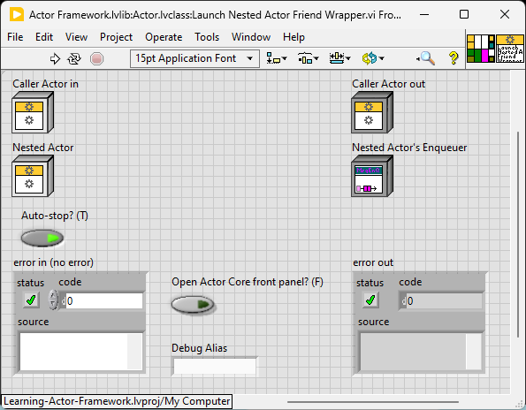
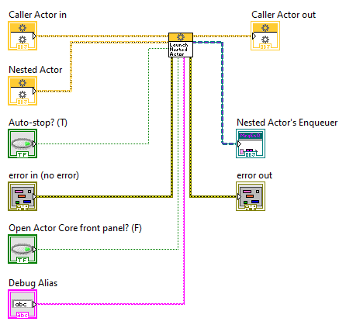
AF.lvlib:Actor.lvclass:Launch Nested Actor Friend Wrapper.vi
Called directly in:
AF.lvlib:Launch Nested Actor Msg.lvclass:Do.vi

Slide 27
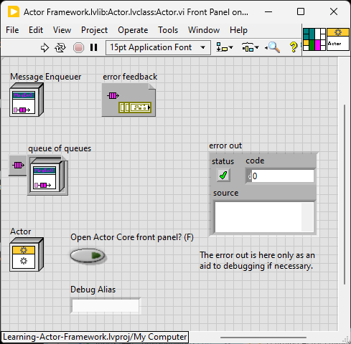
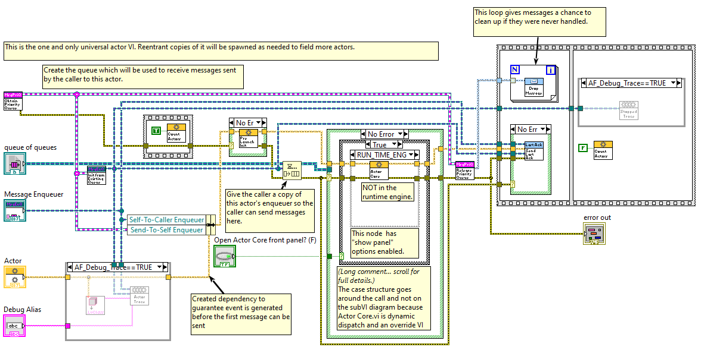
AF.lvlib:Actor.lvclass:Actor.vi
Called directly in:
AF.lvlib:Last Ack.lvclass (is friend of this method)
AF.lvlib:Actor.lvclass:Launch Actor Core.vi

Slide 28
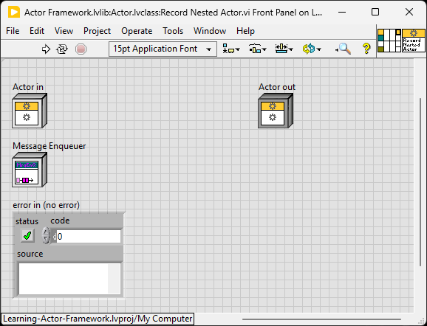
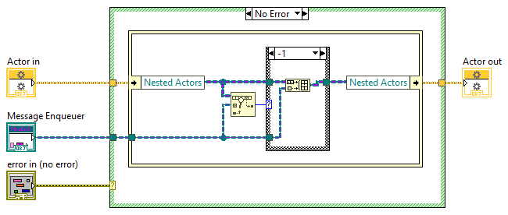
AF.lvlib:Actor.lvclass:Record Nested Actor.vi
Called directly in:
AF.lvlib:Actor.lvclass:Launch Nested Actor.vi

Slide 29
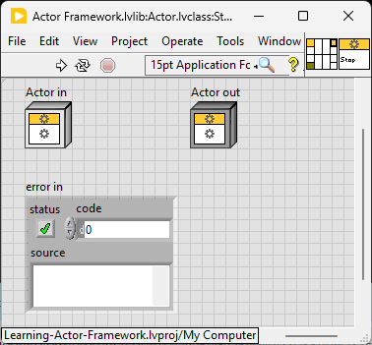
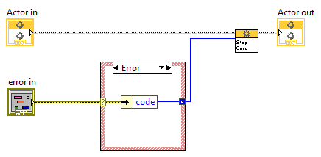
AF.lvlib:Actor.lvclass:Stop.vi
Called directly in:
AF.lvlib:Actor.lvclass:Actor Core.vi

Slide 30
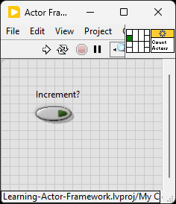
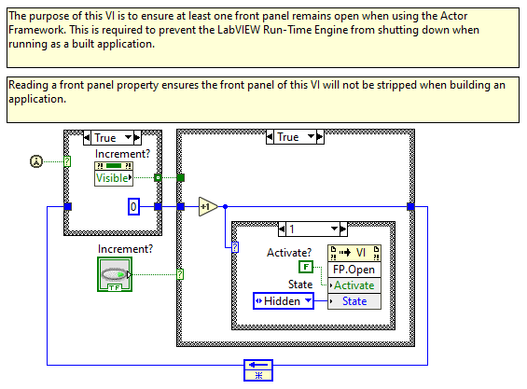
AF.lvlib:Actor.lvclass:Count Actors.vi
Called directly in:
AF.lvlib:Actor.lvclass:Actor.vi

Slide 31
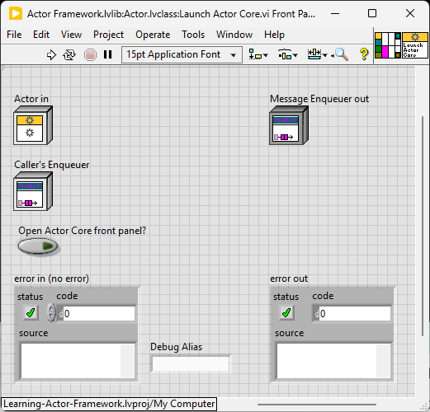

AF.lvlib:Actor.lvclass:Launch Actor Core.vi
Called directly in:
AF.lvlib:Actor.lvclass:Launch Root Actor.vi
AF.lvlib:Actor.lvclass:Launch Nested Actor.vi
AF.lvlib:Actor.lvclass:Launch Actor.vi

Slide 32


AF.lvlib:Actor.lvclass:Actor Core.vi
Called directly in:
AF.lvlib:Actor.lvclass:Actor.vi

Slide 33


AF.lvlib:Actor.lvclass:Stop Core.vi
Called directly in:
AF.lvlib:Actor.lvclass:Stop.vi
Enter Self Actor into “Destroying” state

Slide 34


AF.lvlib:Actor.lvclass:Handle Last Ack Core.vi
Called directly in:
AF.lvlib:Actor.lvclass:Handle Last Ack.vi

Slide 35


AF.lvlib:Actor.lvclass:Read Self Enqueuer.vi
Called directly in:
AF.lvlib:Actor.lvclass:Launch Nested Actor.vi

Slide 36


AF.lvlib:Actor.lvclass:Read Caller Enqueuer.vi
No direct calls

Slide 37


AF.lvlib:Actor.lvclass:Read Autostop Nested Actor Count.vi
No direct calls

Slide 38


AF.lvlib:Actor.lvclass:Receive Message.vi
Called directly in:
AF.lvlib:Actor.lvclass:Actor Core.vi

Slide 39


AF.lvlib:Actor.lvclass:Handle Error.vi
Called directly in:
AF.lvlib:Actor.lvclass:Actor Core.vi

Slide 40


AF.lvlib:Actor.lvclass:Pre Launch Init.vi
Called directly in:
AF.lvlib:Actor.lvclass:Actor.vi

Slide 41


AF.lvlib:Actor.lvclass:Substitute Actor.vi
No direct calls

Slide 42


AF.lvlib:Actor.lvclass:Send Launch Nested Actor Msg.vi
No direct calls

Slide 43


AF.lvlib:Actor.lvclass:Launch Nested Actor.vi
Called directly in:
AF.lvlib:Actor.lvclass:Launch Nested Actor Friend Wrapper.vi
Record Nested Actor (which is in case structure here) should NOT have an error case structure inside since the internals should always execute. In the case structure below, the error input should not go into Record Nested Actor.. rather, there should be an error case structure outside of the case structure holding Record Nested Actor, which checks if there is an error. This means also, deleting the error input on Record Nested Actor.
Assume the caller DOES stick around. (Comment below)

Slide 44


AF.lvlib:Actor.lvclass:Launch Actor.vi
No direct calls

Slide 45


AF.lvlib:Actor.lvclass:Launch Root Actor.vi
No direct calls

Slide 46

AF.lvlib:Message Priority Queue.lvclass
Contained elements:
AF.lvlib:Message Priority Queue.lvclass:DVR Contents.ctl
AF.lvlib:Message Priority Queue.lvclass:Dequeue Timed Out.vi
AF.lvlib:Message Priority Queue.lvclass:Obtain Priority Queue.vi
AF.lvlib:Message Priority Queue.lvclass:Priority Enqueue.vi
AF.lvlib:Message Priority Queue.lvclass:Priority Dequeue.vi
AF.lvlib:Message Priority Queue.lvclass:Flush.vi
AF.lvlib:Message Priority Queue.lvclass:Release Priority Queue.vi
No Friends

Slide 47

AF.lvlib:Message Priority Queue.lvclass:DVR Contents.ctl
Called directly in:
AF.lvlib:Message Priority Queue.lvclass:private data
AF.lvlib:Message Priority Queue.lvclass:Dequeue Timed Out.vi
AF.lvlib:Message Priority Queue.lvclass:Obtain Priority Queue.vi

Slide 48


AF.lvlib:Message Priority Queue.lvclass:Dequeue Timed Out.vi
Called directly in:
AF.lvlib:Message Priority Queue.lvclass:Priority Dequeue.vi

Slide 49


AF.lvlib:Message Priority Queue.lvclass:Obtain Priority Queue.vi
Called directly in:
AF.lvlib:Init Actor Queues FOR TESTING ONLY.vi
AF.lvlib:Message Queue.lvclass:Obtain Message Queue.vi
AF.lvlib:Actor.lvclass:Actor.vi

Slide 50


AF.lvlib:Message Priority Queue.lvclass:Priority Enqueue.vi
Called directly in:
AF.lvlib:Message Enqueuer.lvclass:Enqueue.vi
AF.lvlib:Message Enqueuer.lvclass:Enqueue Critical.vi

Slide 51


AF.lvlib:Message Priority Queue.lvclass:Priority Dequeue.vi
Called directly in:
AF.lvlib:Actor.lvclass:Actor Core.vi
AF.lvlib:Message Dequeuer.lvclass:Dequeue.vi

Slide 52


AF.lvlib:Message Priority Queue.lvclass:Flush.vi
No direct calls

Slide 53


AF.lvlib:Message Priority Queue.lvclass:Release Priority Queue.vi
Called directly in:
AF.lvlib:Message Queue.lvclass:Release Message Queue.vi
AF.lvlib:Actor.lvclass:Actor.vi

Slide 54

AF.lvlib:Message Enqueuer.lvclass
Contained elements:
AF.lvlib:Message Enqueuer.lvclass:Init from Existing Queue.vi
AF.lvlib:Message Enqueuer.lvclass:Enqueue Critical.vi
AF.lvlib:Message Enqueuer.lvclass:Message Priority.ctl
AF.lvlib:Message Enqueuer.lvclass:Enqueue.vi
AF.lvlib:Message Enqueuer.lvclass:Equals Not A Refnum.vi
Friends: AF.lvlib
AF.lvlib:Actor.lvclass
AF.lvlib:Last Ack.lvclass
AF.lvlib:Message Queue.lvclass
AF.lvlib:Stop Msg.lvclass
reason to have these others here, why not just AF.lvlib, since all other classes are within AF.lvlib

Slide 55


AF.lvlib:Message Enqueuer.lvclass:Init from Existing Queue.vi
Called directly in:
AF.lvlib:Init Actor Queues FOR TESTING ONLY.vi
AF.lvlib:Message Queue.lvclass:Obtain Message Queue.vi
AF.lvlib:Actor.lvclass:Read Self Enqueuer.vi
AF.lvlib:Actor.lvclass:Actor.vi

Slide 56


AF.lvlib:Message Enqueuer.lvclass:Enqueue Critical.vi
Called directly in:
AF.lvlib:Last Ack.lvclass:Send Last Ack.vi
AF.lib:Stop Msg.lvclass:Send Emergency Stop.vi

Slide 57

AF.lvlib:Message Enqueuer.lvclass:Message Priority.ctl
Called directly in:
AF.lvlib:Message Enqueuer.lvclass:Enqueue.vi
AF.lvlib:Message Enqueuer.lvclass:Enqueue Critical.vi
AF.lvlib:Actor.lvclass:Send Launch Nested Actor Msg.vi

Slide 58


AF.lvlib:Message Enqueuer.lvclass:Enqueue.vi
Called directly in:
AF.lib:Stop Msg.lvclass:Send Normal Stop.vi
AF.lvlib:Actor.lvclass:Send Launch Nested Actor Msg.vi

Slide 59


AF.lvlib:Message Enqueuer.lvclass:Equals Not A Refnum.vi
Called directly in:
AF.lvlib:Actor.lvclass:Launch Nested Actor.vi
AF.lvlib:Actor.lvclass:Launch Actor.vi

Slide 60

AF.lvlib:Message Dequeuer.lvclass
Contained elements:
AF.lvlib:Message Dequeuer.lvclass:Init from Existing Queue
AF.lvlib:Message Dequeuer.lvclass:Dequeue.vi
AF.lvlib:Message Dequeuer.lvclass:Equals Not A Refnum.vi
AF.lvlib:Message Dequeuer.lvclass:Dequeue Priority.ctl
Friends: Actor Framework.lvlib
Message Queue.lvclass

Slide 61


AF.lvlib:Message Dequeuer.lvclass:Init from Existing Queue.vi
Called directly in:
AF.lvlib:Init Actor Queues FOR TESTING ONLY.vi
AF.lvlib:Message Queue.lvclass:Obtain Message Queue.vi

Slide 62


AF.lvlib:Message Dequeuer.lvclass:Dequeue.vi
No direct calls

Slide 63


AF.lvlib:Message Dequeuer.lvclass:Equals Not A Refnum.vi
No direct calls

Slide 64

AF.lvlib:Message Dequeuer.lvclass:Dequeue Priority.ctl
Called directly in:
AF.lvlib:Message Dequeuer.lvclass:Dequeue.vi

Slide 65

AF.lvlib:Message Queue.lvclass
Contained elements:
AF.lvlib:Message Queue.lvclass:Obtain Message Queue.vi
AF.lvlib:Message Queue.lvclass:Read Dequeuer.vi
AF.lvlib:Message Queue.lvclass:Read Enqueuer.vi
AF.lvlib:Message Queue.lvclass:Release Message Queue.vi
No Friends

Slide 66

AF.lvlib:Message Queue.lvclass:Obtain Message Queue.vi
No direct calls

Slide 67


AF.lvlib:Message Queue.lvclass:Read Dequeuer.vi
No direct calls

Slide 68


AF.lvlib:Message Queue.lvclass:Read Enqueuer.vi
No direct calls

Slide 69


AF.lvlib:Message Queue.lvclass:Release Message Queue.vi
No direct calls

Slide 70


AF.lvlib:Init Actor Queues FOR TESTING ONLY.vi
Called directly in:
AF.lvlib:Actor.lvclass (is friend of this method)

